Slide 1
The Final Software Project final project
Ricardo Wyatt
CST499: Capstone for Computer Software Technology (CSF2315A)
Instructor: Elchouemi
May 15, 2023

Slide 2
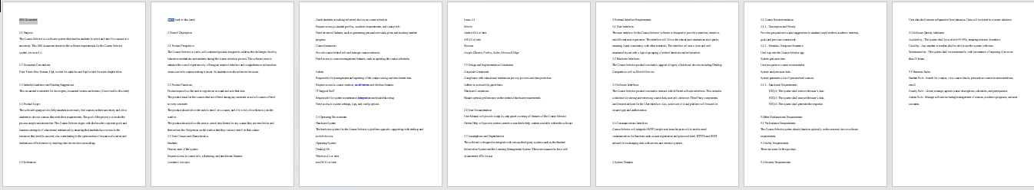
SRS Document
This SRS Document describes the functionality the product needs to fulfill the needs of all stakeholders. Within this document the course selector is described as a software system that enable students to select and enroll in courses at a university.
Product Scope: Purpose is to help students more easily enroll for courses in university also aligns with the broader corporate goals and business strategies of educational institutions by ensuring that students have access to the resources they need to succeed.

Slide 3
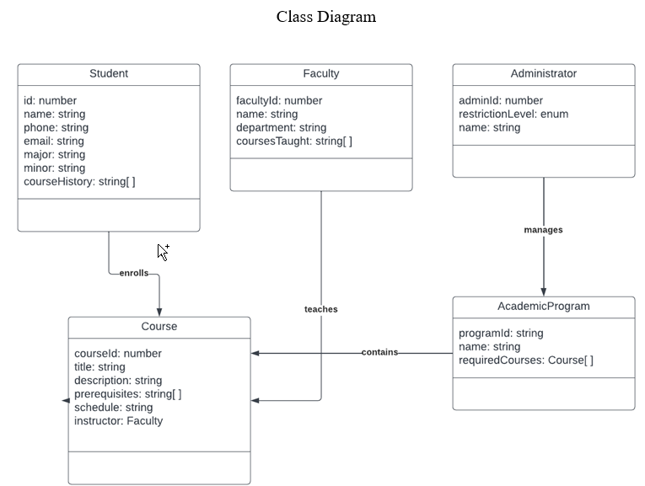
UML - Class Diagram
This class diagram is the blueprint of objects
that make up the Student enrollment. It displays
relationships between the objects, and describe
what the objects do and services they provide.

Slide 4
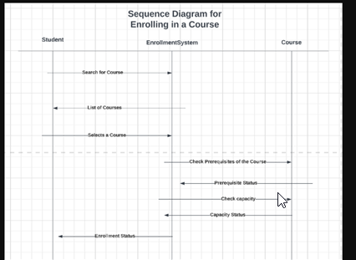
UML - Sequence Diagram
The sequence diagram shows a group
of objects represented by lifelines
in enrolling in a course and the messages
they exchange over time during the
Interaction during enrollment

Slide 5
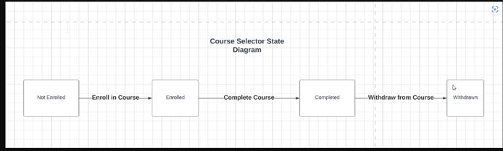
UML - State Diagram
This state diagram describes the
Behavior of the single object in response
to the series of events that follow in the
Course Selector system.

Slide 6
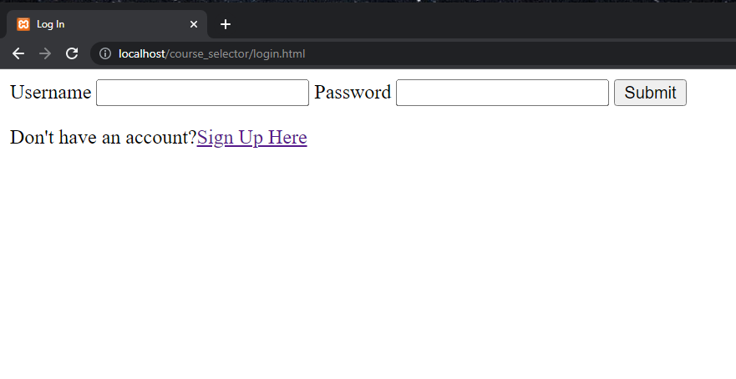
Login, Register and Enrollment
Simple design, focused on functionality over presentation.
Works by making connection to MySQL database using PHP script
Script takes necessary data like email and password, and runs a query to add the user to the database
For Logging in, we simply take the data from the HTML form, then perform a query to see if a record with that the username and password has been created before.
For Enrollment, we add the user id and course id as a field in the user_courses table.

Slide 7
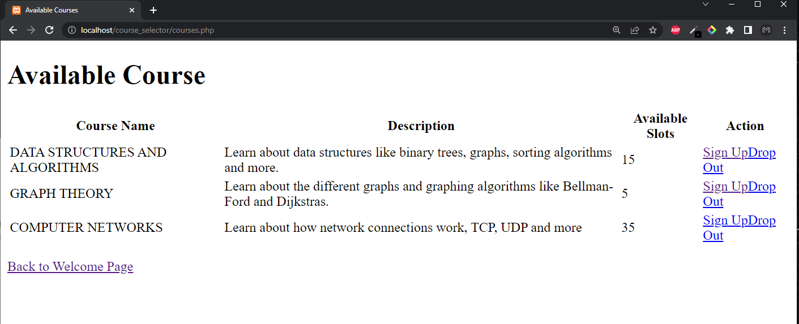
Website Design
The Available Courses page will showcase all the courses that someone has created in the table by creating a query on the courses table.
Using PHP, we are able to display all that data, one row at a time.
Something similar is done for the My Courses page.

Slide 8
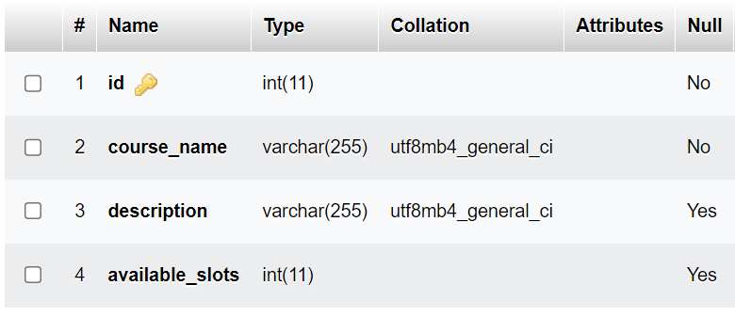
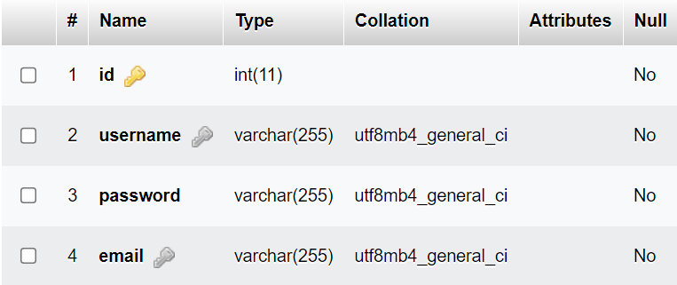
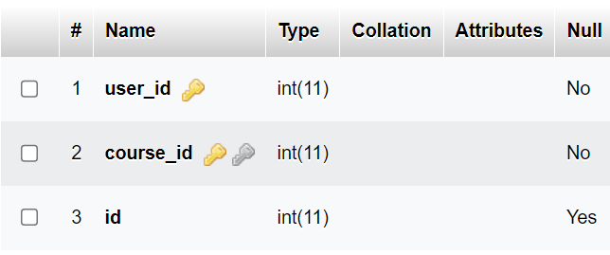
Database
Created a total of three tables in the database called course_selector.
users table provides data like username, email and password
courses table provides data like course_name, description and available_slots
user_courses provides a connection between the user id and the course id

Slide 9
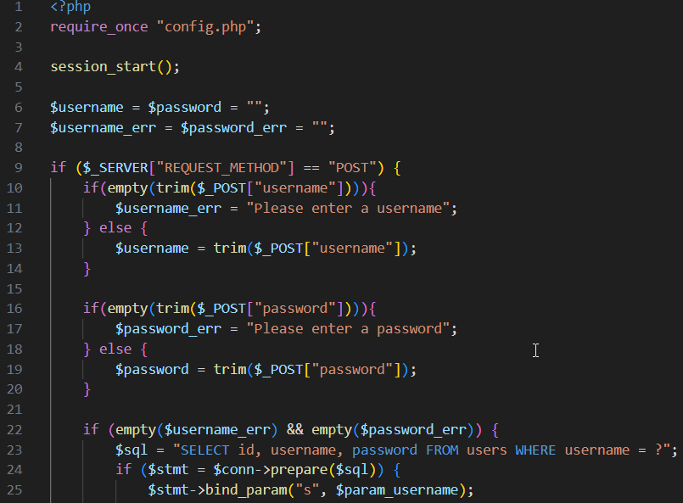
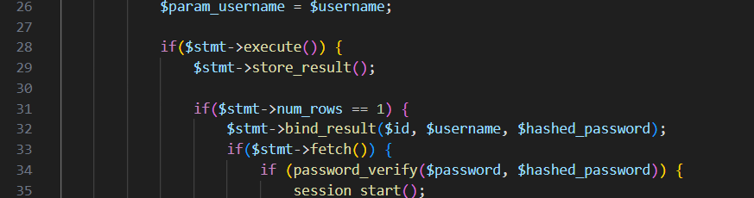
PHP Code - Login / Register
We get the necessary data from the login/register HTML page using a form.
We do some error checking on the username and password
Then we perform a query to either add them to the users table (if we are registering) or we perform a query to find them (if we are logging in)
If all goes well, we will push the user to the welcome page.

Slide 10
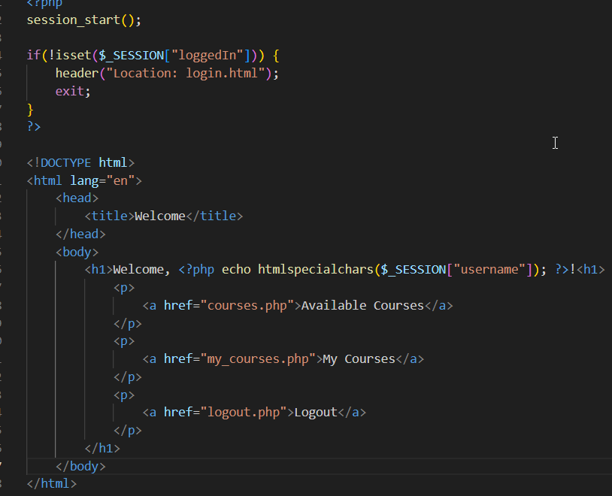
PHP Code - Welcome Page
We check that the user is logged in, if they aren’t we bring them back to the login page.
The HTML will display their name and then a few choices for other routes like My Courses and Available Courses

Slide 11
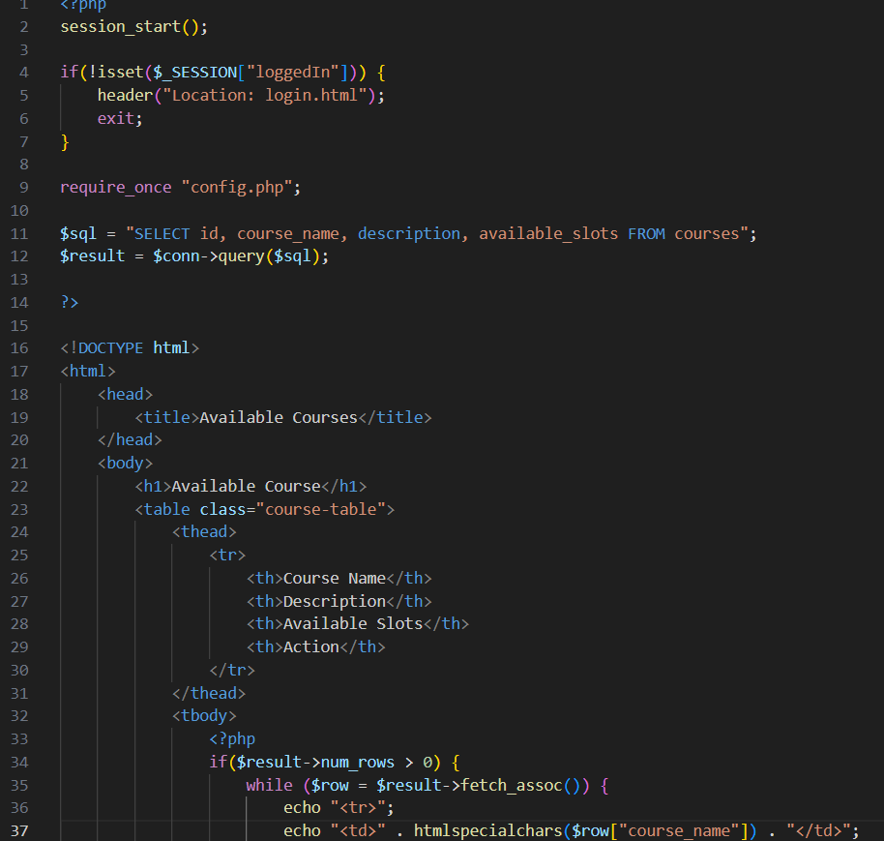
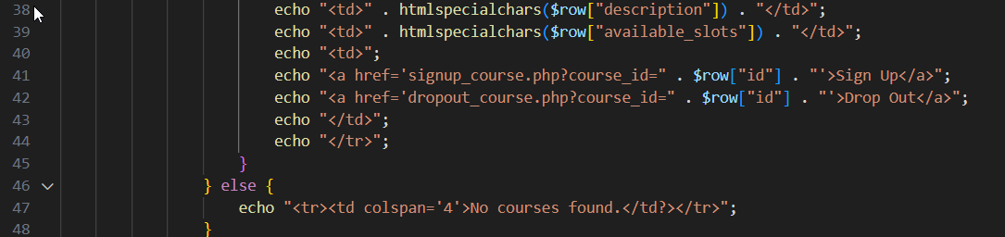
PHP Code - Available Courses
This code will make a query on the courses table, getting all the records that have been creating in the table
Then it will go row by row, and display the data of that course using `fetch_assoc()` with a while loop.

Slide 12
References
https://www.geeksforgeeks.org/software-requirement-specification-srs-format/?ref=gcse
Spillner, A., Linz, T., & Schaefer, H. (2014). Software testing foundations: A study guide for the certified tester exam (4th ed.). Rocky Nook.

